Slide 1



History Begins With U
Learn It!

Slide 2
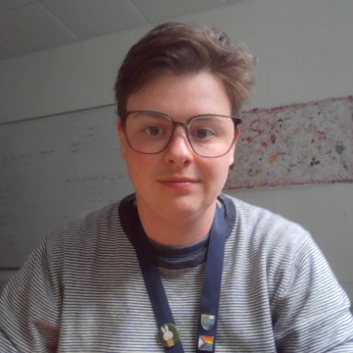
I’m really excited that you are taking part in our project “History begins with U”.
This is a series of activities that will help you learn about past discoveries, try out some current science, and think to the future about how you might make history!
I hope you enjoy it, and I look forward to meeting you soon!

Slide 3
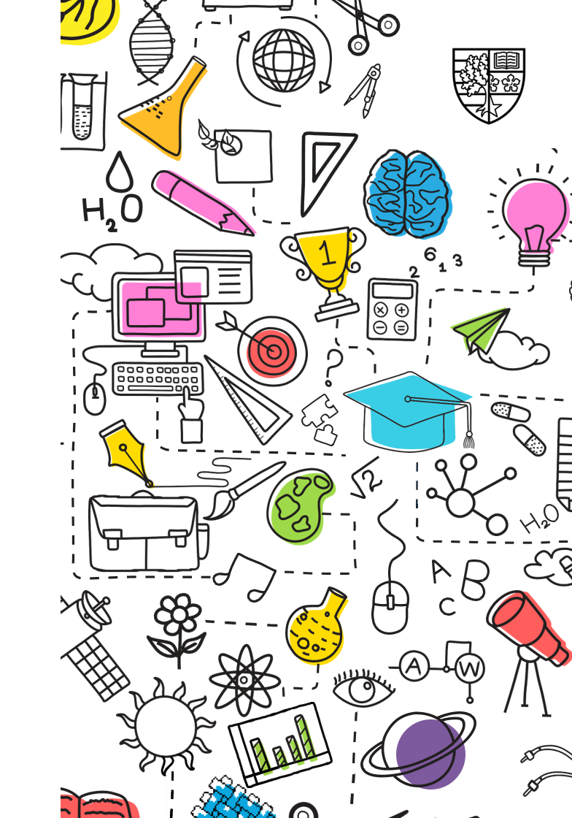
What is a University?
On the back of your feedback slip please write a short description of what you think university is.
If you’re unsure or don’t know – that’s okay, you can write that too!

Slide 4
What is a University?
University is a school you can choose to go to as an adult, to learn about a subject in lots of detail. It can help you learn skills for different jobs.
There are other people who work at university called academics who teach students as well as research answers to big questions.

Slide 5

Why do students go to Uni?
Help prepare them for work.
Learn more about a subject they enjoy.
Make new friends and see new places.
Notes:
These next few slides give some answers to common questions we get from young people. Please do add your own experiences of university too! If your class has more questions you’d like us to answer, please send them ahead of our “try it” workshop.

Slide 6
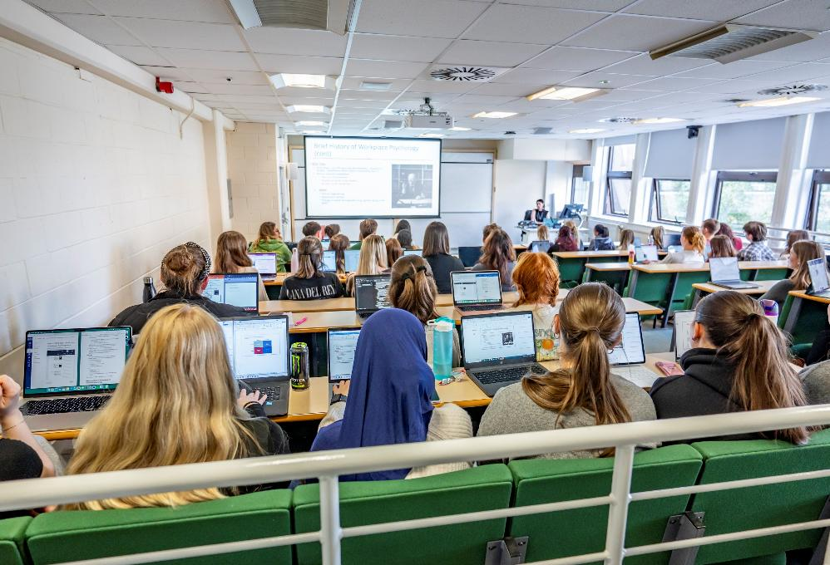
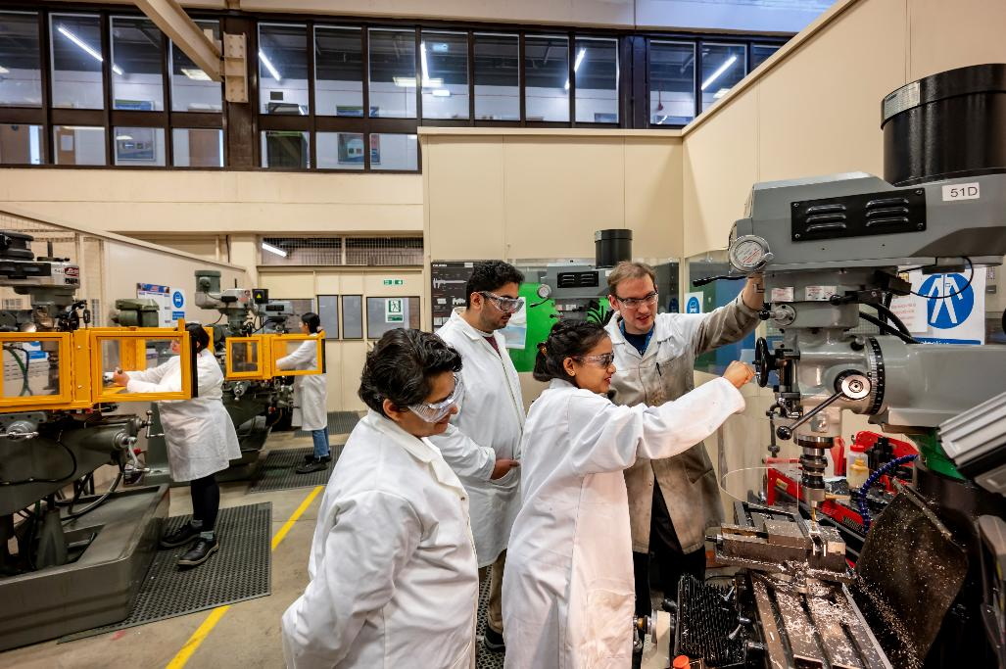
What does a uni look like?
Notes:
Classes can be big or small. Many subjects have lab work in rooms with special equipment. This is our mechanical engineering lab.

Slide 7
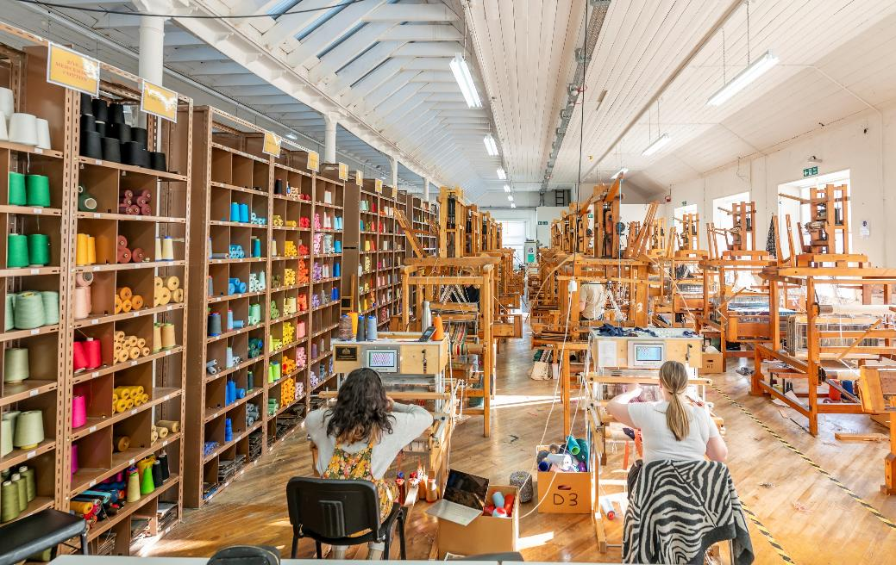
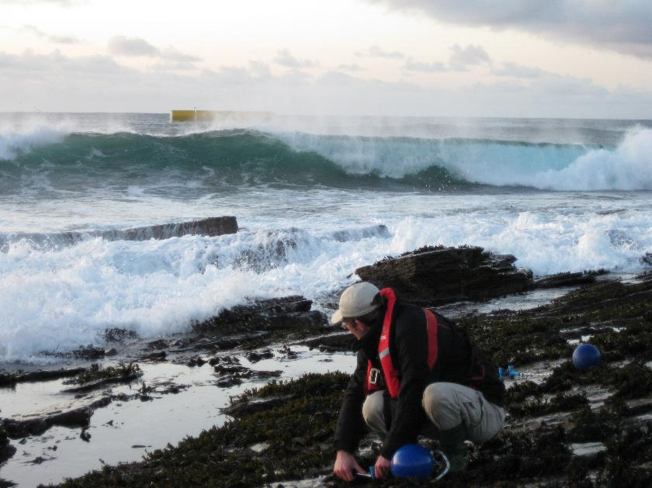
What does a uni look like?
Notes:
This is the weaving shed in our Borders campus where fashion and textiles students might work. Other subjects require fieldwork – like this marine biologist out working on the coast of Orkney.

Slide 8
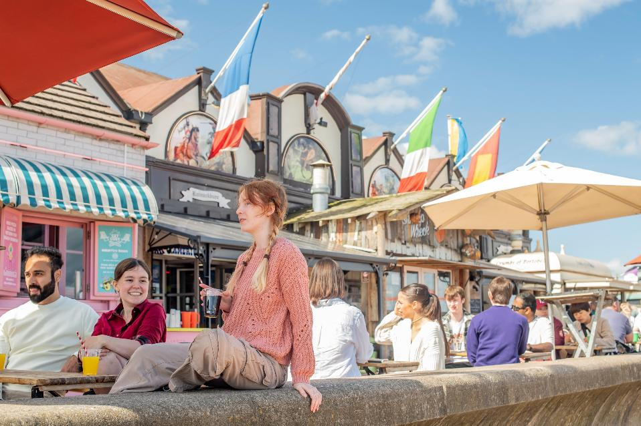
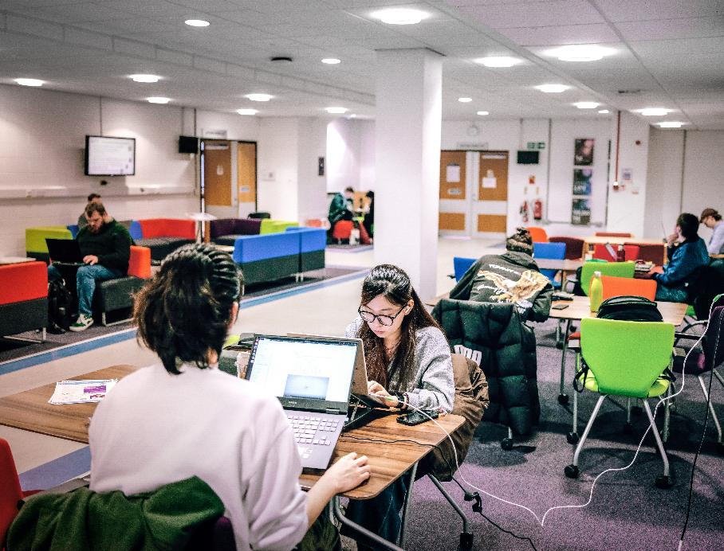
What does a uni look like?
Notes:
Uni students also spend time out with friends, or studying with classmates.

Slide 9
How do you get into uni?
Age 17+, no upper age limit!
Study your Highers or similar qualifications in school or college.
Apply online.
Choose from thousands of different subjects.

Slide 10
What are university classes like?
Lecture
Students sit and listen to the lecturer tell them information. They may take notes and ask questions, but it’s more like an assembly than a class discussion.
Tutorial
Class of students led through groupwork with a tutor.
Often involves practicing problems or project work.
Lab
Practical work in a room with special equipment. Labs can look very different depending on what subject they are for and you work in small groups or pairs.

Slide 11
Activity 1: A Week at University
University can look very different depending on what subject you’re studying, what other activities you choose to take part in, what university you go to…
We’ve borrowed one of our student's timetables to give you an example of their normal week at university.
Take time to read it over and draw a comic strip (or write a description) of what one day at university might look like. Include what you think they might be up to in their free time too!

Slide 12
Time: | Time: | Time:
Time: | Time: | Time:
Notes:
Template for activity. Pupils should choose one day of the week and draw or write descriptions of what the student does. Encourage descriptions of activities not included in the timetable (e.g. traveling, meeting friends, clubs and sports…).

Slide 13
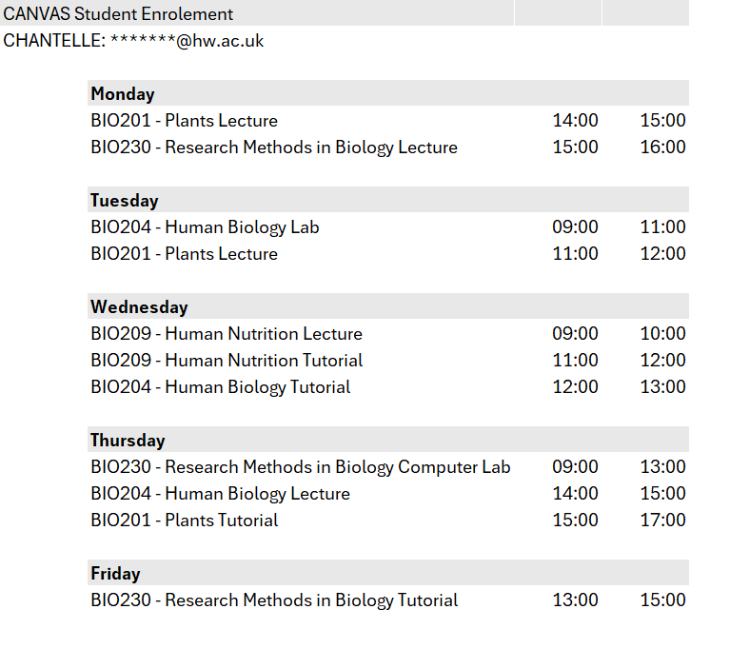
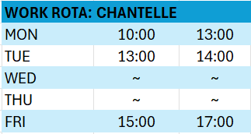
Activity 1: A Week at University
Library study group Fridays
09:00 – 12:00
Notes:
Optional detailed timetables to extend learning (CfE MNU 2-10a).

Slide 14
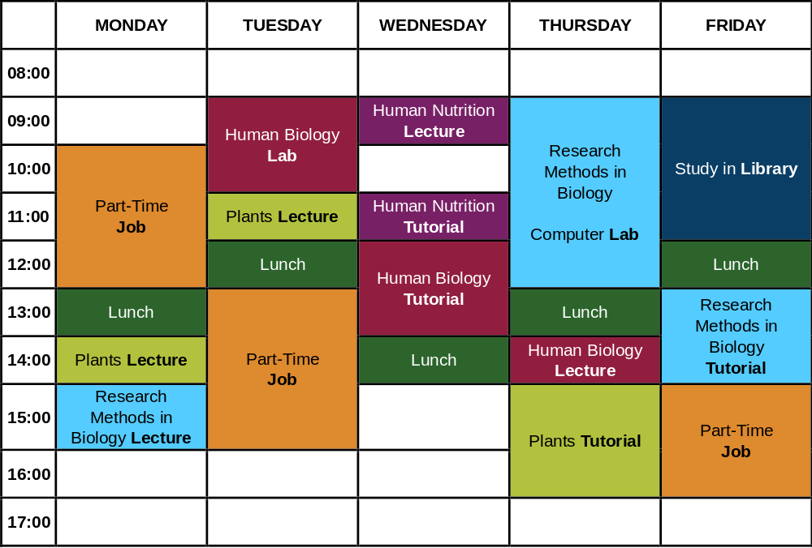
Notes:
Timetable for activity 1.
The highlighted Tuesday links to the real pictures of Chantelle's day on the following slide.

Slide 15
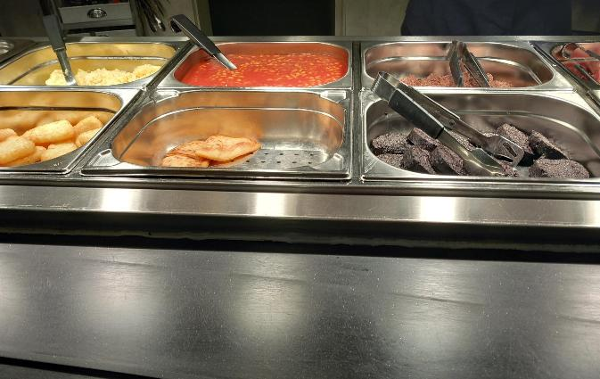
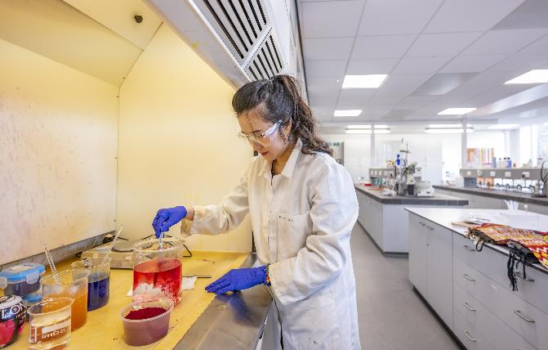
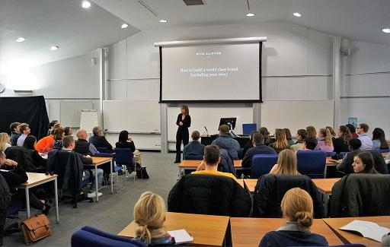
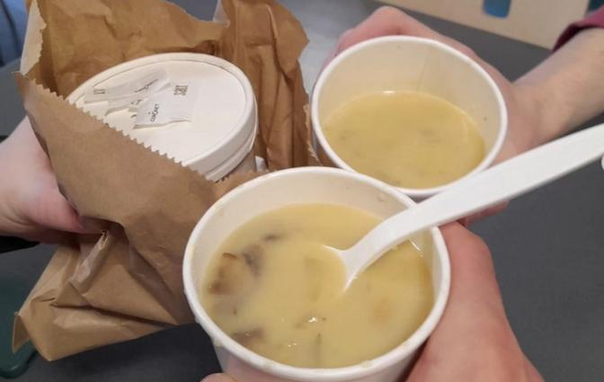
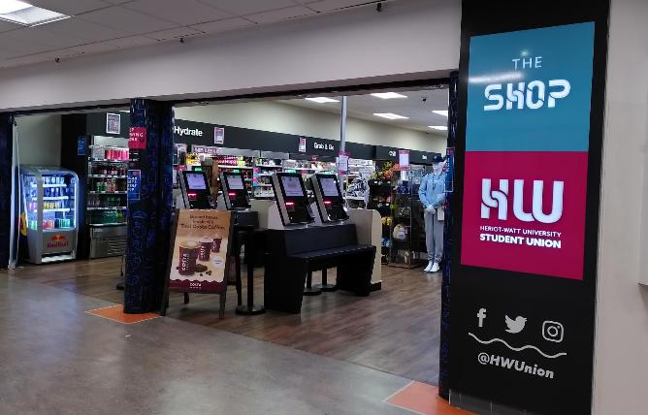
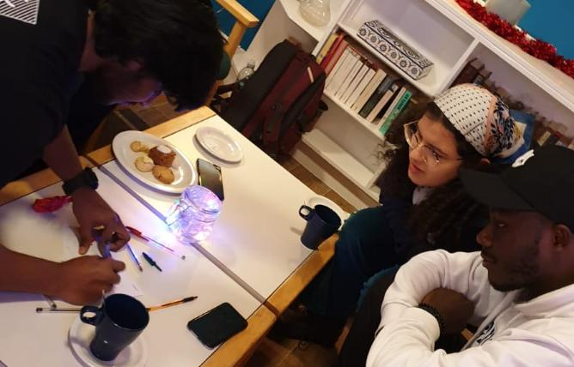
Roll and potato scone for breakfast from the university canteen. Time: 8:30 am | Stock photo of HWU lab because you’re not allowed to have your phone with you! Time: 9 -11 am | Dr Kangs lectures are pretty good, I usually take notes on my laptop. Time: 11-12 am
Soup lunch! Cream of mushroom. Time: 12-1 pm | Work in the student shop (photo taken after the big rush at lunch time!) Time: 1- 4 pm | Rohan trying to explain his mechanical engineering project to us after dinner. Time: 7 pm
Notes:
This is Chantelle's Tuesday as a biology student. Ask pupils to think if this is what they thought her day would look like. Is it similar or different to their own day at school?

Slide 16


BRAIN BREAK
Please take part if this movement feels right for you.
Desk Based Stretches
Mobility and flexibility can be improved by regular stretching.
Notes:
This is one slide of a collection (produced by the HWU wellbeing team with Oriam) that lecturers are encouraged to use to give uni students a short brain break. We thought they were great to include in our resources too!

Slide 17
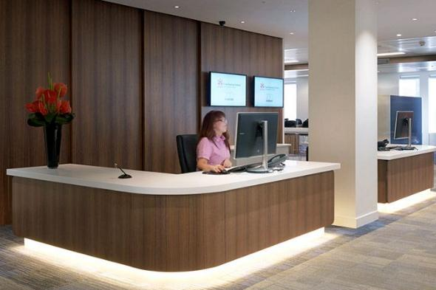
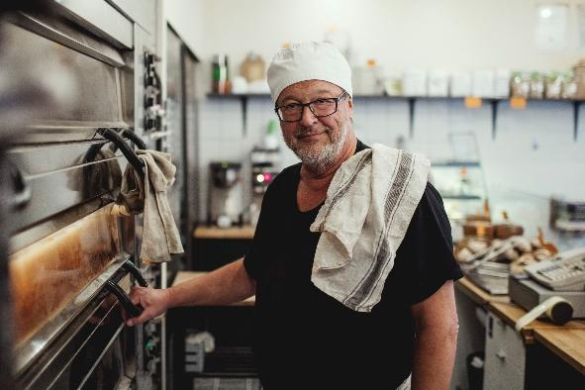
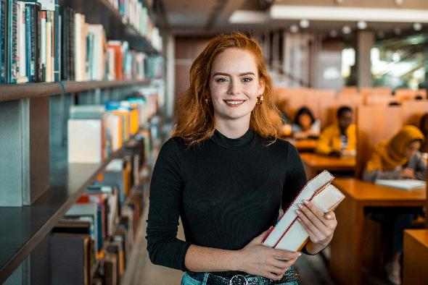
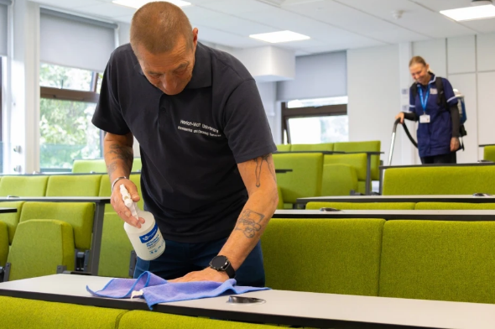
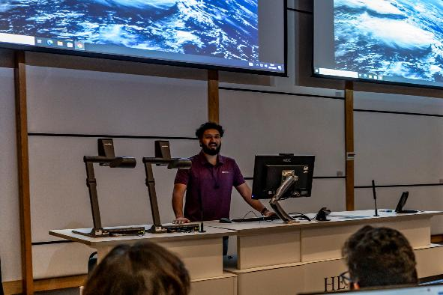
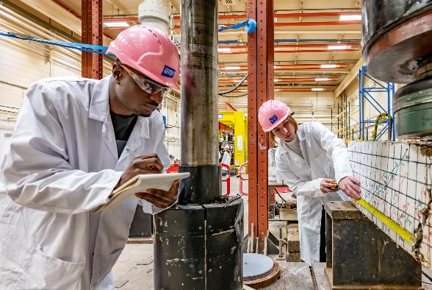
Who works at university?
Notes:
Ask pupils to suggest who else goes to their school, other than students. Discuss the similarities to university.
Images of receptionist, cook, librarian, cleaners, academic (teaching), academic (researching).
Heriot-Watt University has around 27,000 students, but we also employ over 2,500 staff members – there are LOADS of people at university.
Some of these are people who work in admin, cleaning, gardening, wellbeing, librarians… all very important to keep the university running!
There are also hundreds of academics – people who are experts in their subject who teach students as well as experiment and research. Academics work on problems no one has answers to yet.

Slide 18
What is an Academic?
Academics are experts in their subject working in a university.
They might teach classes of students, work as part of a research team, or both.
Academics often research questions we don’t have the answers to yet. Sometimes these are linked to a real-world problem, but some research might be more abstract.
Notes:
Summary of what an academic is – the job can look very different depending on what subject and what other roles an academic decides to do in the university.

Slide 19
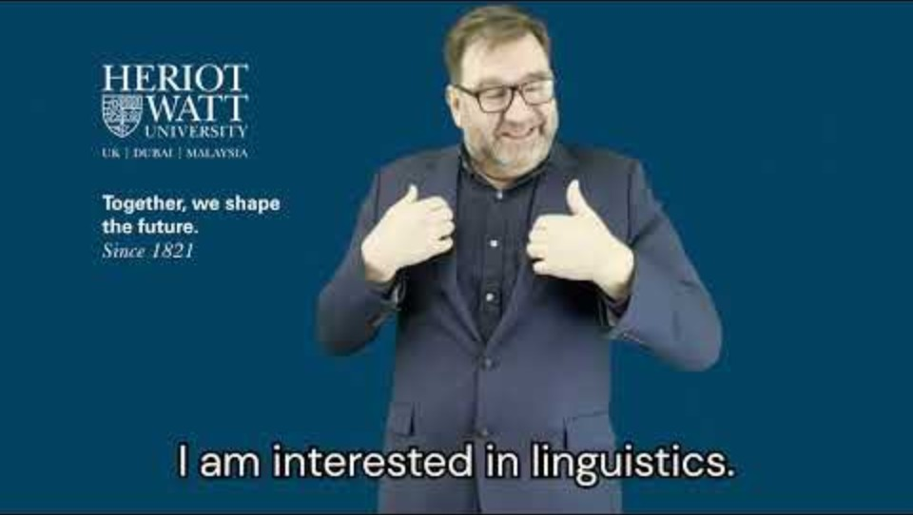
Notes:
https://www.youtube.com/watch?v=-bULk048caE

Slide 20
Activity 2: Puzzle Time!
Now that you’ve met some of our lovely academics, Jane has a maths puzzle for you!
Draw a grid 4 squares across and 4
squares down.
Draw one continuous line that goes in every box only once – no overlapping.
How many different solutions can you find?
Notes:
Activity 2: Short maths puzzle. Could be done by folding scrap paper to make the grid and using different colours for each solution pupils can find. There are many many ways to solve this puzzle, ask pupils to compare with their neighbours/table to find as many different lines as possible. An extension could be to use an 8X8 grid.
Approx. 5 minutes

Slide 21

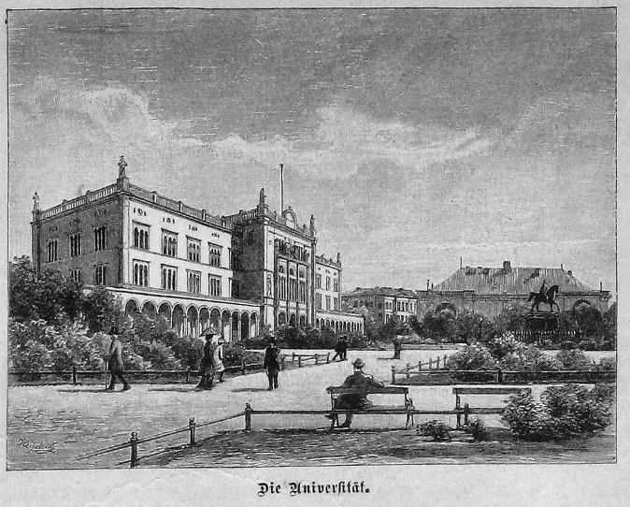
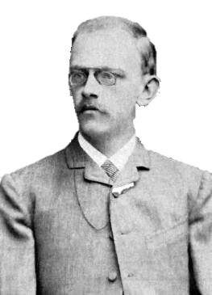
David Hilbert
David Hilbert was an academic at the University of Königsberg in Germany in the 1890’s. He researched and taught mathematics.
He worked on the same puzzle, and this was his solution:
He challenged himself with extra rules to make sure this pattern would work with an infinite size of grid!
Ich liebe ein gutes rätsel!
Notes:
In 1891, David Hilbert enjoyed working on the same puzzle. He’d read about others solutions and thought he’d have a go to improve on the result.
German translation: “I love a good puzzle!”, colourised image of David Hilbert and the university of Königsberg both dated ~late 1800’s early 1900’s.

Slide 22
…Why Though?
David was pleased enough with his solution that he wrote it out to show to his other mathematician friends. It did solve the maths problem in a way no one had ever answered before, but in 1891 this piece of maths wasn’t very useful.
It was a fun puzzle and that was all. But over 100 years later, the maths behind this “Hilbert Curve” now lets us:
Das ist wunderbar!
connect to the internet
find the best travel routes
upload / download images quickly
create better digital maps
Notes:
In David Hilbert’s time: electric streetlights were fairly recent (1878), most people would not have a telephone in their homes, this was around the invention of the gramophone that would allow people to listen to recorded music at home (rather than visiting the dance halls).
It would not be possible for him to consider that his solution to a maths puzzle would solve the modern problem of “how do we send memes to our friends?”.
German translation: “That’s wonderful/amazing!”

Slide 23
New maths and science discoveries can solve problems that haven’t even been invented yet!

Slide 24
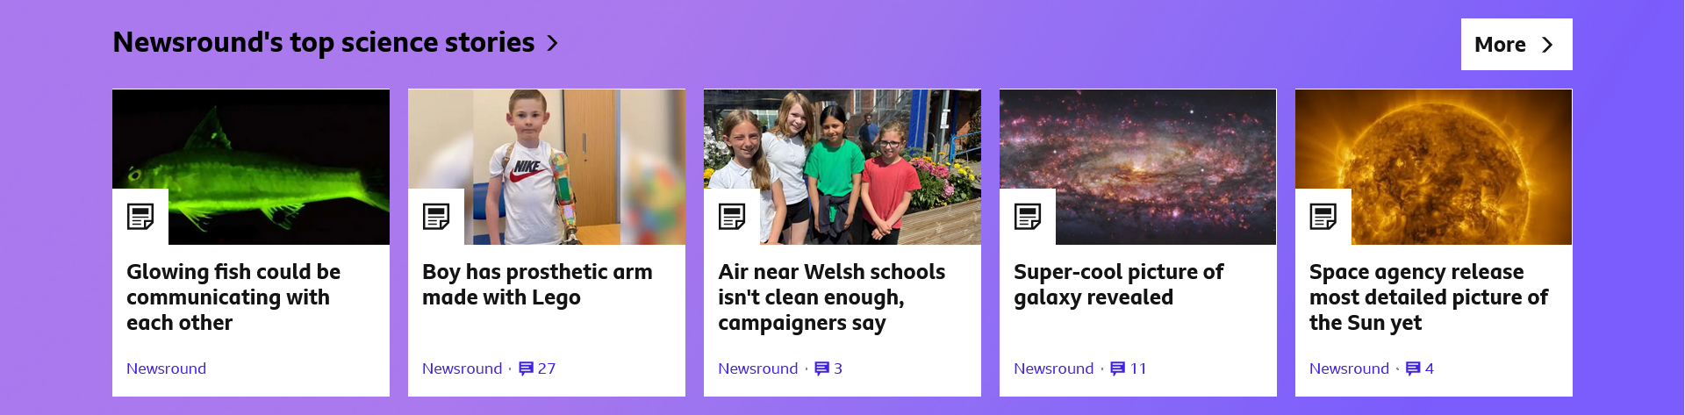
Current Research
What questions are academics trying to answer right now?
Find out more about scientific research or a new discovery you find interesting.
Notes:
Option: discuss a different topical science example (e.g. from Newsround, linking to topic or local news).
https://www.bbc.co.uk/cbbc/curations/science-on-cbbc.
STEM ambassadors or other members of the school community might be able to speak about their work in science and technology too.

Slide 25
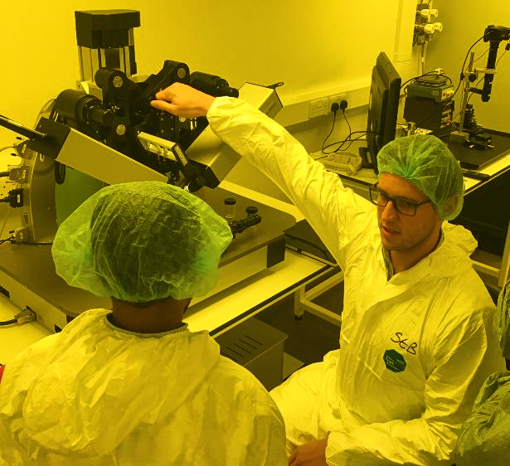
Current Research
Many academics make use of the nanofabrication lab at Heriot-Watt.
The lab has a lot of interesting equipment to carry our experiments that are incredibly small – 1/10,000 of a cm!
These experiments are extremely sensitive, so you
must wear overalls, hair nets and shoe covers to
make sure no dirt contaminates the room.
They can make tiny precise components used in
supercomputers, advanced medical devices, and
other electronics. They also use the laser
equipment to make changing 3D holograms.
Notes:
This is included just as one example of cutting-edge work at Heriot-Watt. If pupils have follow-up questions about the lab, please send them on, we’d be happy to talk more about it when we visit.
Nanofabrication: nano = microscopic size, fabrication = making.
This lab makes super super small things and uses a variety of very specific machines to do this. It’s a funny yellow as the machines are sensitive to light.

Slide 26
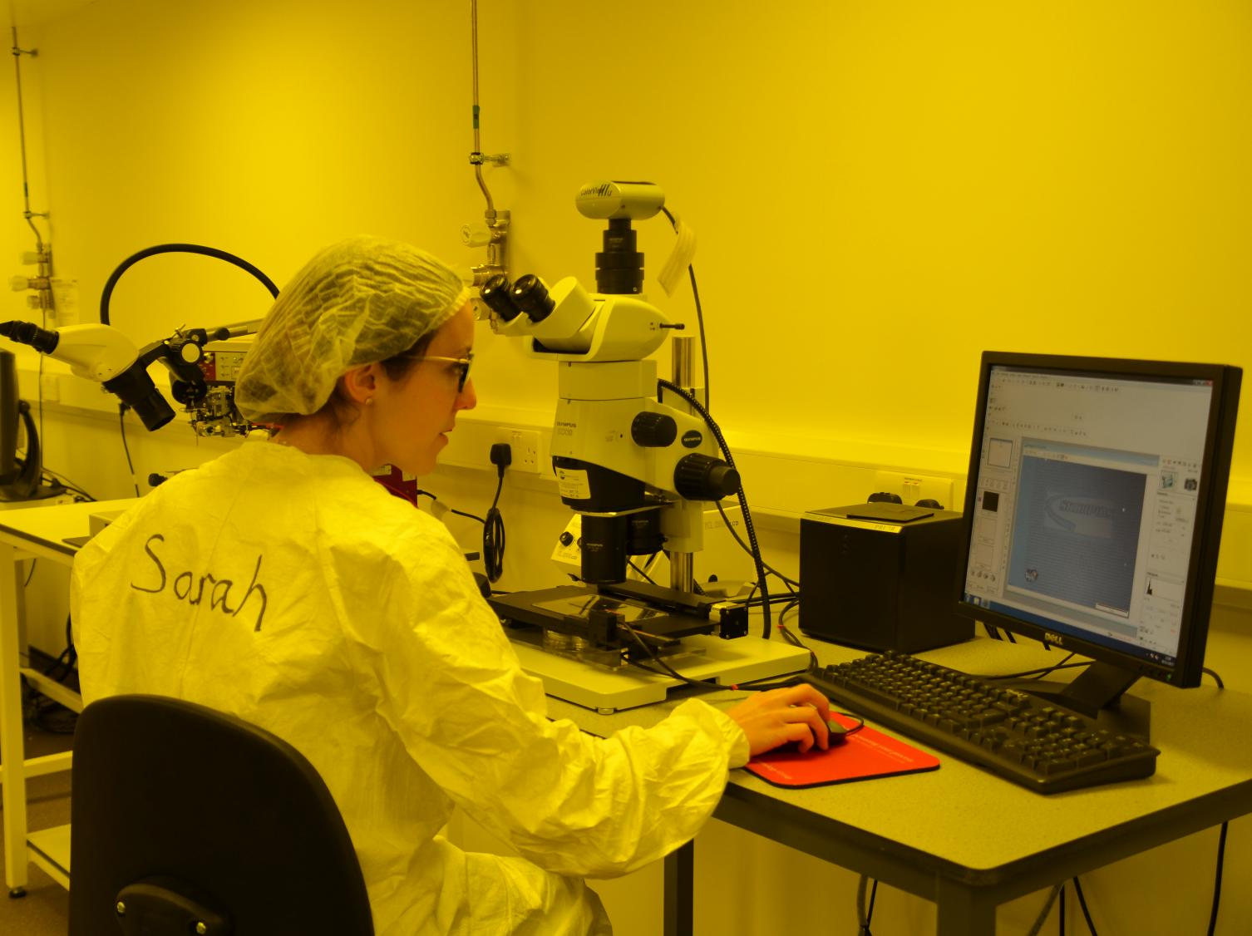
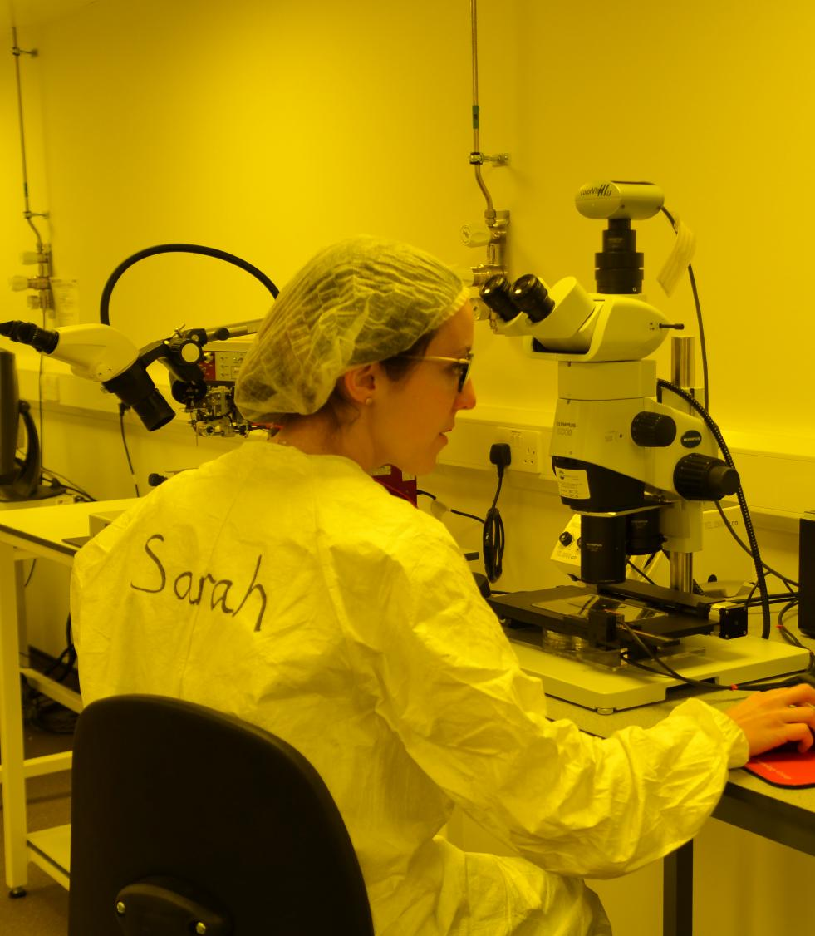
I’m Sarah, I work in the nanofabrication lab.
I use machines that help me control lasers to make tiny electrical components. I need to use microscopes to see these as they are so small.
We’re still experimenting, but in the future these electrical components might help us make better medical devices, solar panels, and other electronics!

Slide 27

Activity 3: Imagining the Future
You learned how the solution to David Hilbert’s maths puzzle has led to all sorts of new technologies a hundred years later.
Try imagine how the future might be changed by the discoveries that are happening today.
What could tiny robots be used for? How might electronics help look after people? What would you like a supercomputer to calculate? How could you use a really
powerful solar panel?
Notes:
Activity 3: Ask pupils to try to imagine what this research could be used for in the future.
Abstract ideas are welcome, but pupils should be encouraged to present a reasoned argument based on evidence – such as highlighting a link from their idea to the underlying science/topic of research. E.g. nanofabrication might lead to tiny tiny robots that can go inside someone to kill a virus (unlikely, but it wouldn’t it be cool!)
Work individually, pairs, groups or full class discussion as preferred.
Note: change prompt questions as appropriate if the class have explored other research.

Slide 28
The Role of a University
It’s a place students can go to learn more about a subject/topic that they really like.
It can help prepare students for different jobs.
Academics teach students and also research questions we don’t have answers to yet.
A lot of information that was discovered in the past is very helpful when trying to solve modern problems – what exciting discoveries are next?
Notes:
Summary of key learning points.

